Slide 1
Concurrency: Thread
Dr. Probir Roy
Some slides are modified from
* Dr. Shengquan Wang
Operating Systems: Three Easy Pieces, by Remzi H. Arpaci-Dusseau and Andrea C. Arpaci-Dusseau
Operating System Concepts, 8th edition, by Silberschatz, Galvin, Gagne, John Wiley & Sons, 2009

Slide 2
Outline
Multi-threading

Slide 3



An example: web server
Problems in a web server
Thousands of concurrent accesses.
Enormous waiting time for some clients with server running as a single process.
Original solution
Creating multiple processes to serve all accesses.
What’s the problem?
A busy web server

Slide 4
An example: web server (cont.)
Problems with multiple processes:
Time consuming and resource intensive in creating a new process.
Better solution
Light-weight process: thread
A busy web server

Slide 5
New abstraction: multi-threading
Traditional process
A single point of execution within a program, i.e., a single PC (program counter) where instructions are being fetched from and executed.
A multi-threaded process
More than one point of execution, i.e., multiple PCs, each of which is being fetched and executed from.
Threads in a process share the same address space.

Slide 6
Multi-threaded process in memory

Slide 7
Features
Unique for each thread
Program counter (PC)
Register set
Stack
Shared address space
Code
Data
Heap
Open files

Slide 8
Benefits of multi-threading
Resource sharing: sharing memory.
Responsiveness: fast thread-creating.
Parallel executing
Utilizing multi cores: e.g, adding two large arrays together in parallel
Avoiding blocking program progress due to slow I/O (e.g., loading web pages with images).
Notes:
8

Slide 9
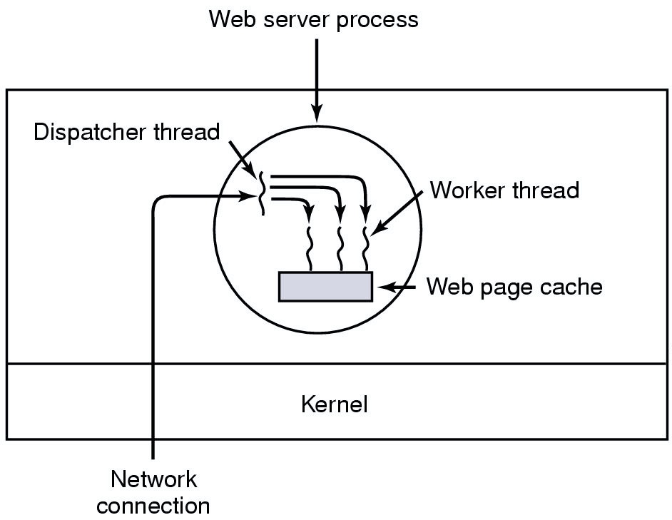
A multithreaded web server
Notes:
9

Slide 10
Thread control block (TCB)
TCB contain thread specific information such as
PC
thread state (running, …)
register values
stack pointer
a pointer to PCB
…

Slide 11
Context switches with multithreading
Same
The address space remains the same.
Differences
The context switch is performed between threads as compared to processes.
Need one or more TCBs to store the state of each thread instead of PCBs.

Slide 12
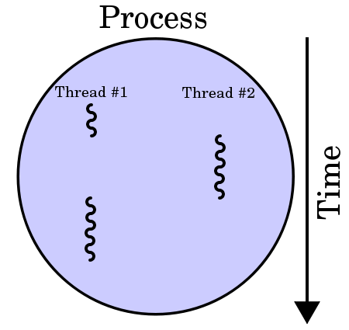
Multi-threaded process execution
A process with two threads of execution on a single processor:
http://en.wikipedia.org/wiki/Thread_(computing)

Slide 13
Summary: Process vs. thread
Process
Memory isolation for protection and reliability
e.g.: Google Chrome browser
Thread
Fast in creating threads.
Saving memory space by sharing among different threads from the same process if possible.
e.g.: web servers

Slide 14
Analogy: two one-bedroom apartments
Bathroom
Bedroom
Bathroom
Bedroom
Kitchen
Living room
Kitchen
Living room
Each one has his/her own one-bedroom apartment.

Slide 15
Analogy: one two-bedroom apartment
Bedroom I
Bathroom
Bedroom II
Kitchen
Living room
Two roommates share a two-bedroom apartment.

Slide 16
Outline
Multi-threading
Pthread

Slide 17
Thread library
A thread library provides an API for creating and managing threads.
How to implement a thread library? (system design issue)
All codes and data structure for the library exist in user space (local function call).
All codes and data structure for the library exist in kernel space (system call).

Slide 18
What are Pthreads?
Historically, hardware vendors have implemented their own proprietary versions of threads.
Not portable.
Pthread is a standardized thread programming interface.
Specified by the IEEE POSIX (portable operating systems interface) in 1995.
UNIX and Linux.
Pthreads are defined as a set of C language programming types and procedure calls.
Implemented with a pthread.h header/include file and a thread library.

Slide 19
Thread APIs
int pthread_create( pthread_t *restrict tid, const pthread_attr_t *restrict attr, void *(*start_routine)(void *), void *restrict arg)
The tid returns the new thread ID.
The attr parameter is used to set thread attributes, NULL for the default values.
The start_routine is the C routine that the thread will execute once it is created.
A single argument may be passed to start_routine via arg. It must be passed by reference as a pointer cast of type void.

Slide 20
Creating a thread
#include <pthread.h>
typedef struct __myarg_t {
int a;
int b;
} myarg_t;
void *mythread(void *arg) {
myarg_t *m = (myarg_t *) arg;
printf("%d %d\n", m->a, m->b);
return NULL;
}
…
…
int main(int argc, char *argv[]) {
pthread_t p;
int rc;
myarg_t args;
args.a = 10;
args.b = 20;
rc = pthread_create(&p, NULL, mythread, &args);
...
}

Slide 21
Thread APIs (cont’d)
void pthread_exit(void *value_ptr)
It terminates the calling thread and makes the value value_ptr available to any successful join with the terminating thread.
int pthread_join(pthread_t tid, void **value_ptr)
It blocks the calling thread until the specified tid thread terminates.
Return 0 on success, and negative on failure.
The returned value is a pointer returned by reference.
If you do not care about the return value, you can pass NULL for the second argument.

Slide 22
Waiting for thread completion
#include <stdio.h>
#include <pthread.h>
#include <assert.h>
#include <stdlib.h>
typedef struct __myarg_t {
int a;
int b;
} myarg_t;
typedef struct __myret_t {
int x;
int y;
} myret_t;
void *mythread(void *arg) {
myarg_t *m = (myarg_t *) arg;
printf("%d %d\n", m->a, m->b);
myret_t *r = malloc(sizeof(myret_t));
r->x = 1;
r->y = 2;
return (void *) r;
}
…
…
int main(int argc, char *argv[]) {
int rc;
pthread_t p;
myarg_t args;
myret_t *m;
args.a = 10;
args.b = 20;
rc = pthread_create(&p, NULL, mythread, &args);
pthread_join(p, (void **) &m);
printf("returned %d %d\n", m->x, m->y);
return 0;
}

Slide 23
Outline
Multi-threading
Pthread
Race Condition

Slide 24
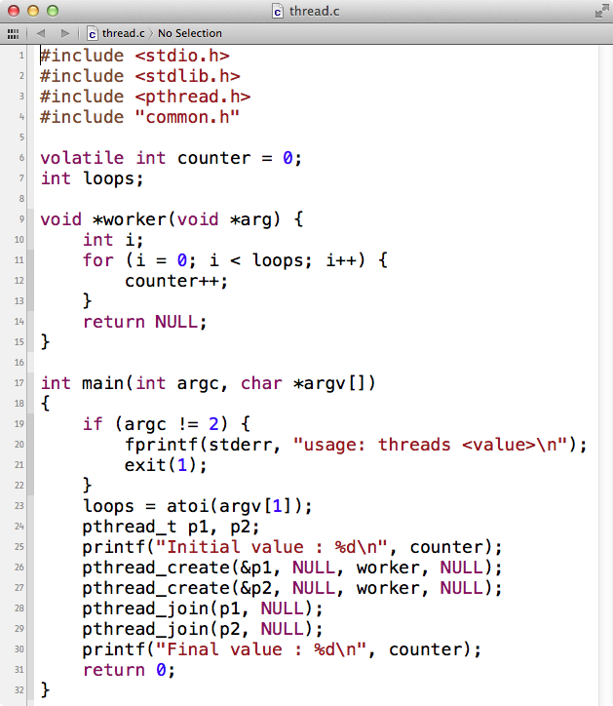
Example: thread.c

Slide 25
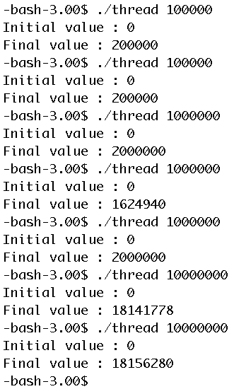
Demo

Slide 26
What happened?
As it turns out, the reason for these odd and unusual outcomes relate to how instructions are executed.
Unfortunately, a key part of the program above, where the shared counter is incremented, takes three instructions:
mov 0x8049a1c, %eax: load the value of the counter from memory into a register
add $0x1, %eax: increment it
mov %eax, 0x8049a1c: store it back into memory
Because these three instructions do not execute atomically (all at once), sorts of strange things can happen.

Slide 27
Uncontrolled scheduling: interleaved operations
 | Thread 1 | Thread 2
Operation | counter = counter + 1 | counter = counter + 1
On CPU | mov: register1 = counter add: register1 = register1 + 1 mov: counter = register1 | mov: register2 = counter add: register2 = register2 + 1 mov: counter = register2
Interleaved execution | mov: register1 = counter add: register1 = register1 + 1 …… …… …… mov: counter = register1 | …… …… mov: register2 = counter add: register2 = register2 + 1 mov: counter = register2 ……
counter = 50
counter = 52
counter = 50
counter = 51

Slide 28
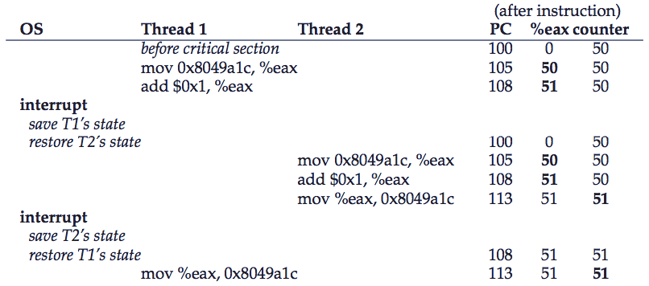
Uncontrolled scheduling: interleaved operations (cont’d)
Code
100 mov 0x8049a1c, %eax
105 add $0x1, %eax
108 mov %eax, 0x8049a1c
before interleaved operation

Slide 29
Simulation: x86.py
./x86.py -p simple-race.s -t 1
./x86.py -p simple-race.s -t 1 -M 2000 -R ax,bx
./x86.py -p loop.s -t 1 -a dx=3 -R dx -C -c
./x86.py -p looping-race-nolock.s -t 2 -a bx=1 -M 2000 -c
./x86.py -p looping-race-nolock.s -t 2 -a bx=1 -M 2000 –i 3

Slide 30
Exercise
./x86.py -p looping-race-nolock.s -t 2 -a bx=1 -M 2000 -R ax,bx -i 3
2000 ax bx Thread 0 Thread 1
0 0 1
? ? ? 1000 mov 2000, %ax
? ? ? 1001 add $1, %ax
? ? ? 1002 mov %ax, 2000
? ? ? ------ Interrupt ------ ------ Interrupt ------
? ? ? 1000 mov 2000, %ax
? ? ? 1001 add $1, %ax
? ? ? 1002 mov %ax, 2000
? ? ? ------ Interrupt ------ ------ Interrupt ------
? ? ? 1003 sub $1, %bx
? ? ? 1004 test $0, %bx
? ? ? 1005 jgt .top
? ? ? ------ Interrupt ------ ------ Interrupt ------
? ? ? 1003 sub $1, %bx
? ? ? 1004 test $0, %bx
? ? ? 1005 jgt .top
? ? ? ------ Interrupt ------ ------ Interrupt ------
? ? ? 1006 halt
? ? ? ----- Halt;Switch ----- ----- Halt;Switch -----
? ? ? 1006 halt

Slide 31
Answer
./x86.py -p looping-race-nolock.s -t 2 -a bx=1 -M 2000 -R ax,bx -i 3
2000 ax bx Thread 0 Thread 1
0 0 1
0 0 1 1000 mov 2000, %ax
0 1 1 1001 add $1, %ax
1 1 1 1002 mov %ax, 2000
1 0 1 ------ Interrupt ------ ------ Interrupt ------
1 1 1 1000 mov 2000, %ax
1 2 1 1001 add $1, %ax
2 2 1 1002 mov %ax, 2000
2 1 1 ------ Interrupt ------ ------ Interrupt ------
2 1 0 1003 sub $1, %bx
2 1 0 1004 test $0, %bx
2 1 0 1005 jgt .top
2 2 1 ------ Interrupt ------ ------ Interrupt ------
2 2 0 1003 sub $1, %bx
2 2 0 1004 test $0, %bx
2 2 0 1005 jgt .top
2 1 0 ------ Interrupt ------ ------ Interrupt ------
2 1 0 1006 halt
2 2 0 ----- Halt;Switch ----- ----- Halt;Switch -----
2 2 0 1006 halt

Slide 32
Quiz
./x86.py -p looping-race-nolock.s -t 2 -a bx=0 -M 2000 -R ax,bx -i 3
2000 ax bx Thread 0 Thread 1
0 0 0
? ? ? 1000 mov 2000, %ax
? ? ? 1001 add $1, %ax
? ? ? 1002 mov %ax, 2000
? ? ? ------ Interrupt ------ ------ Interrupt ------
? ? ? 1000 mov 2000, %ax
? ? ? 1001 add $1, %ax
? ? ? 1002 mov %ax, 2000
? ? ? ------ Interrupt ------ ------ Interrupt ------
? ? ? 1003 sub $1, %bx
? ? ? 1004 test $0, %bx
? ? ? 1005 jgt .top
? ? ? ------ Interrupt ------ ------ Interrupt ------
? ? ? 1003 sub $1, %bx
? ? ? 1004 test $0, %bx
? ? ? 1005 jgt .top
? ? ? ------ Interrupt ------ ------ Interrupt ------
? ? ? 1006 halt
? ? ? ----- Halt;Switch ----- ----- Halt;Switch -----
? ? ? 1006 halt

Slide 33
Quiz: answer
./x86.py -p looping-race-nolock.s -t 2 -a bx=0 -M 2000 -R ax,bx -i 3
2000 ax bx Thread 0 Thread 1
0 0 0
0 0 0 1000 mov 2000, %ax
0 1 0 1001 add $1, %ax
1 1 0 1002 mov %ax, 2000
1 0 0 ------ Interrupt ------ ------ Interrupt ------
1 1 0 1000 mov 2000, %ax
1 2 0 1001 add $1, %ax
2 2 0 1002 mov %ax, 2000
2 1 0 ------ Interrupt ------ ------ Interrupt ------
2 1 -1 1003 sub $1, %bx
2 1 -1 1004 test $0, %bx
2 1 -1 1005 jgt .top
2 2 0 ------ Interrupt ------ ------ Interrupt ------
2 2 -1 1003 sub $1, %bx
2 2 -1 1004 test $0, %bx
2 2 -1 1005 jgt .top
2 1 -1 ------ Interrupt ------ ------ Interrupt ------
2 1 -1 1006 halt
2 2 -1 ----- Halt;Switch ----- ----- Halt;Switch -----
2 2 -1 1006 halt

Slide 34
Why in OS?
The OS was the first concurrent program, and many techniques were created for use within the OS.
Examples:
In xv6, each CPU calls scheduler() after setting itself up, which will modify the shared ptable.
Two processes try to append data to the same file.

Slide 35
Key concurrency terms
Critical section is a segment of code, in which multiple threads may be changing shared variables (or more generally, a shared resource).
Such as “counter++” in previous example.
Multiple threads executing the critical section can result in a race condition.
Such as two threads’ executing “counter++”
Mutual exclusion: If one thread’s PC is already inside its critical section, the others will be prevented from entering theirs.
One kind of synchronization.

